Slide 1


Riemann Zeta Function
Prof : Aqil Al-Azmi
Abdulaziz Al-Arifi
Abdullah Al-Fawaz

Slide 2


OutLine
Background's
Complex Numbers
Infinite Series
Riemann Zeta Function

Slide 3
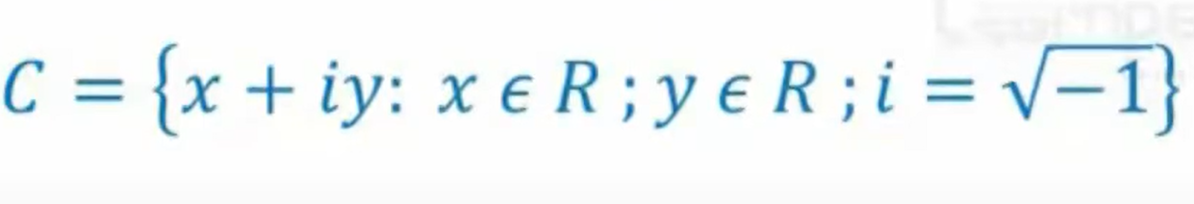
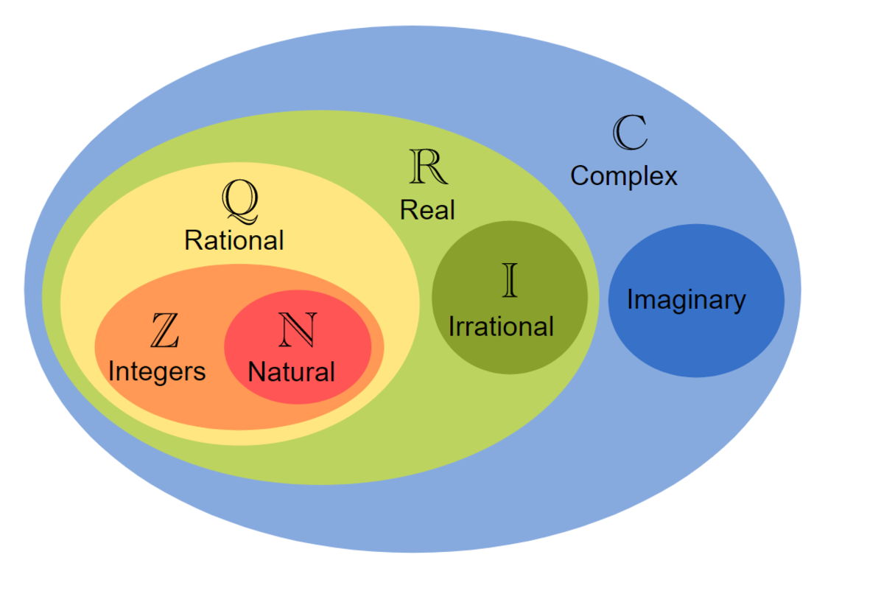
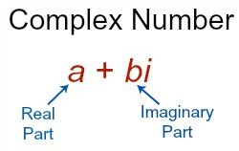
Complex Numbers
complex number : are made up of Real and Imaginary parts.

Slide 4
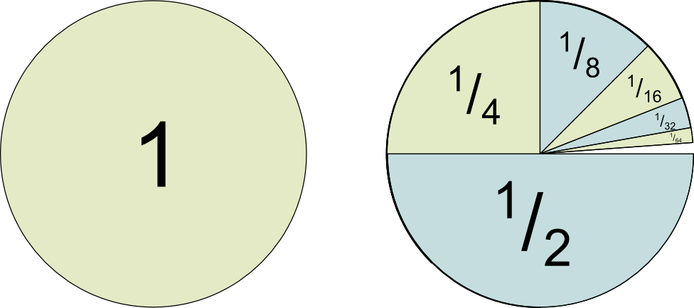
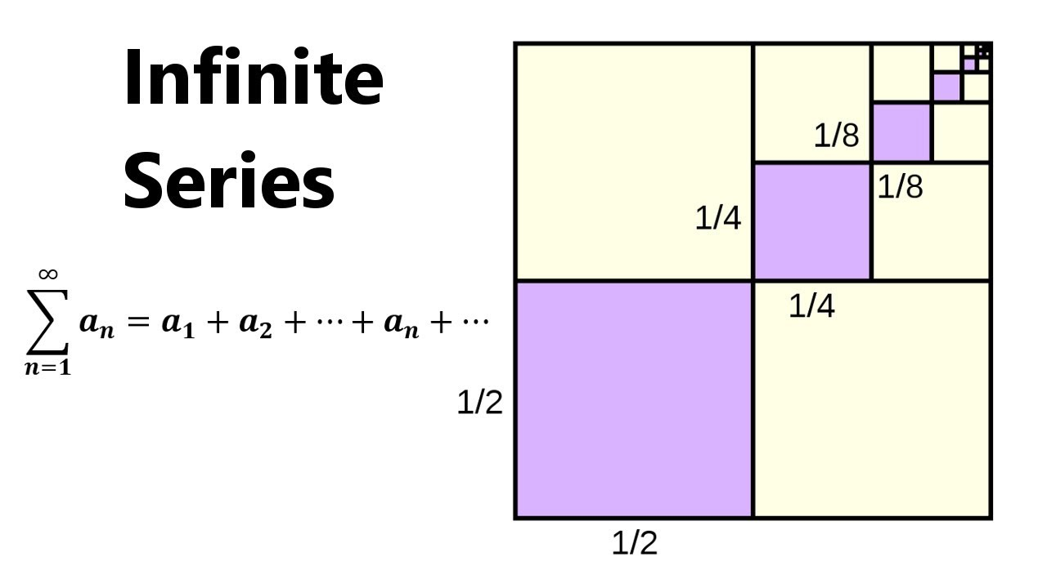
Infinite Series
Infinite Series : The sum of infinite terms that follow a rule.
The sum could be convergent or divergent.

Slide 5
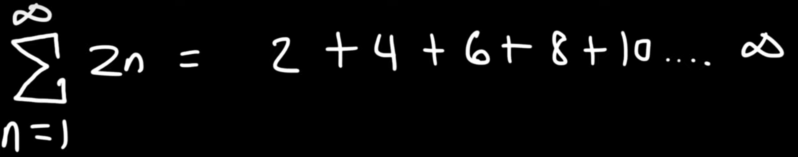
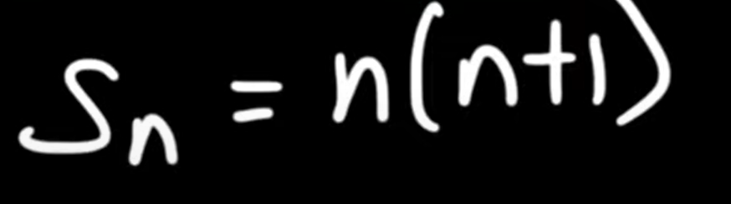
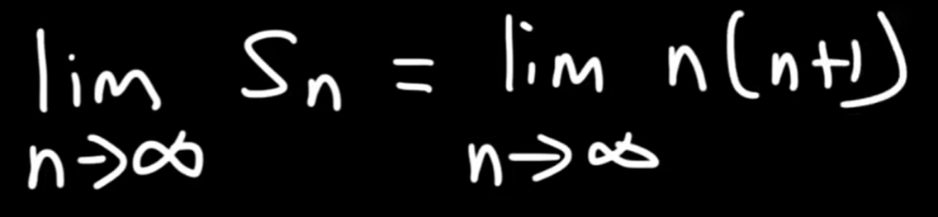
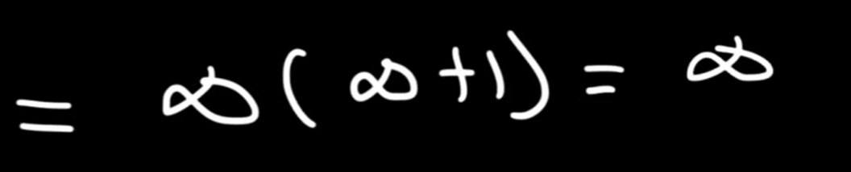
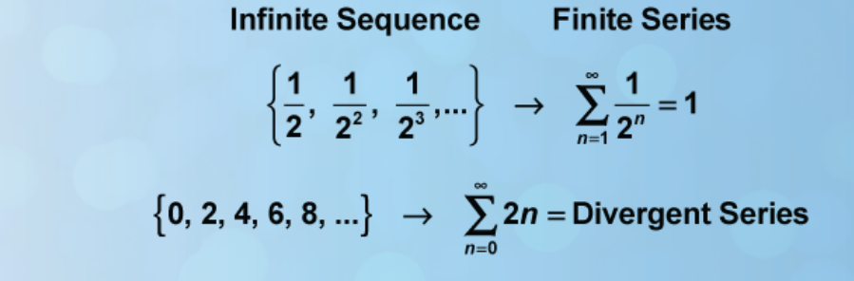
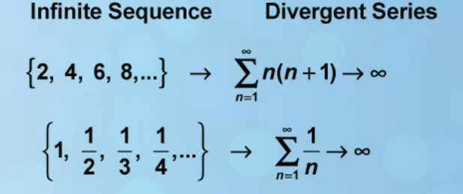
Convergent & Divergent
Convergent Series : When an infinite series equals a specific value, the series is said to be convergent
Divergent Series : When an infinite series becomes infinitely large, the series is said to be divergent

Slide 6
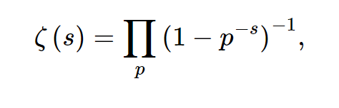
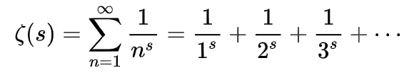
Riemann Zeta Function
Definition : The Riemann zeta function is initially defined for real s > 1 (Where s is complex number) by the convergent series in the picture below.
For real s < 1, it can be defined by analytic continuation.
It also can be defined by Infinite product of primes.

Slide 7
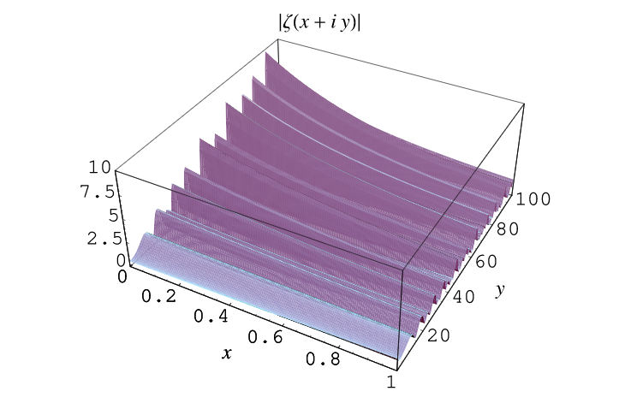
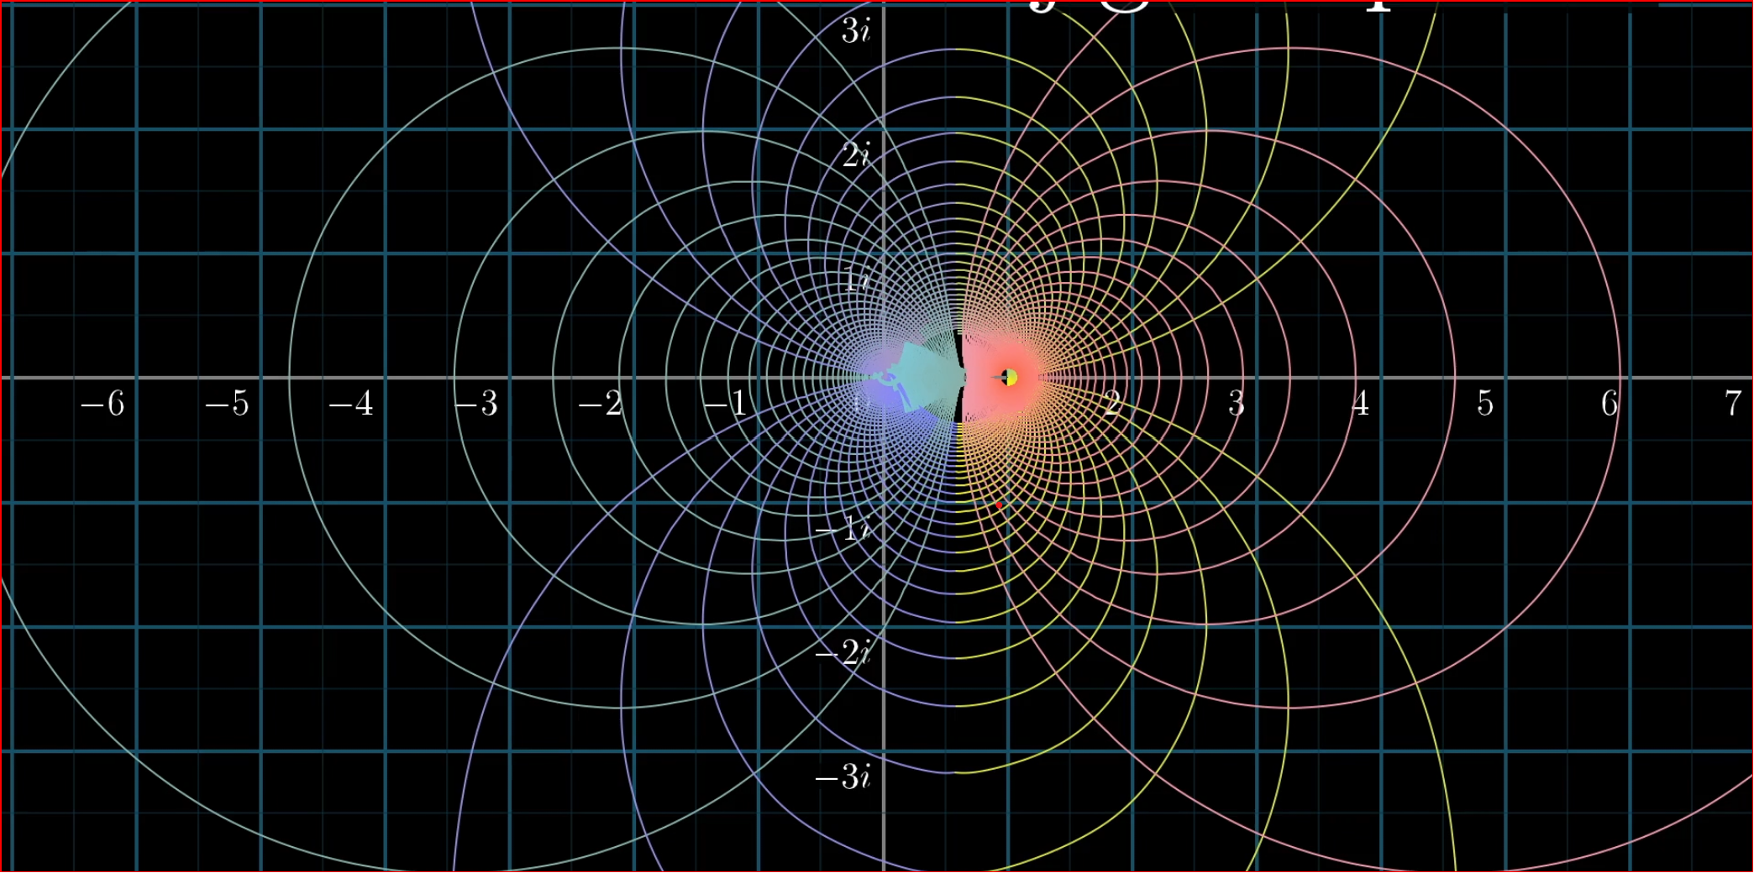
Continued..
In general, zeta(s) is defined over the complex plane for one complex variable.
zeta(s) is implemented in the Wolfram Language as Zeta[s].

Slide 8
Continued...
Mathematicians goal was to obtain formula for π(x) which is the formula of the prime numbers less that x.
The Riemann zeta function plays a pivotal role in analytic number theory.
Riemann zeta function has applications in physics, probability theory, and applied statistics.

Slide 9
Brief History
The theory of which Riemann’s paper is a part had its beginnings in Euler’s theorem, that proved in 1737, that the sum of the reciprocals of the prime numbers.
Riemann extends the definition to complex numbers, but the real part was restricted by integers >1.
Then Chebyshev extends the definition to hold the real part > 1.

Slide 10
Computations and Applications
1+2+3+4….= -1/12 ??
ζ(4) = π^4 /90
ζ(-1.5) = -0.0254852
zeta function is used in conformal field theory and many branches in physics.

Slide 11
References
Calculus by Swokowksi, Olinick and Pence.
Complex Variables and Its Applications By Brown and Churchill.
Math World Site.

Slide 12
Thank You For Good Listing
Any Questions ?

